Slide 1
ML PROJECT
Automated Identification of Gait Abnormalities
TEAM ID- 24
PROJECT ID-28
Notes:
Our project is about identifying gait abnormalities using machine learning.
Gait means the way a person walks.
Certain neurological diseases can affect walking patterns.

Slide 2

INTRODUCTION
Gait: The way a person walks, including step timing, speed and balance.
Neurological diseases can change normal walking patterns.
Abnormalities include irregular steps, shuffling and uneven weight distribution.
Traditional gait assessment relies on visual observation or expensive motion-analysis systems.
Manual assessment can be subjective and time-consuming.
Objective: Use Machine Learning to classify walking patterns as healthy or associated with Parkinson’s, Huntington’s or ALS.
Notes:
Traditional assessment may rely on visual observation or expensive equipment.
Manual assessment is time taking.
So, our objective is to use machine learning to analyze walking sensor data and classify it into four categories: Healthy, Parkinson's disease, Huntington's disease and ALS.

Slide 3
Diseases and Their Gait Characteristics
Parkinson’s Disease (PD)
Disease: A neurological disorder that affects movement control.
Gait: Short, shuffling steps, altered walking rhythm and reduced foot force.
Huntington’s Disease (HD)
Disease: An inherited neurological disorder that affects movement and coordination.
Gait: Irregular steps with large variations in step timing.
Amyotrophic Lateral Sclerosis (ALS)
Disease: A neurological disease that damages motor neurons and causes muscle weakness.
Gait: Reduced foot force, uneven walking and prolonged stance phases.
Healthy Controls
Condition: Individuals without the three targeted neurological diseases.
Gait: Regular step timing, consistent rhythm and balanced left-right movement.

Slide 4
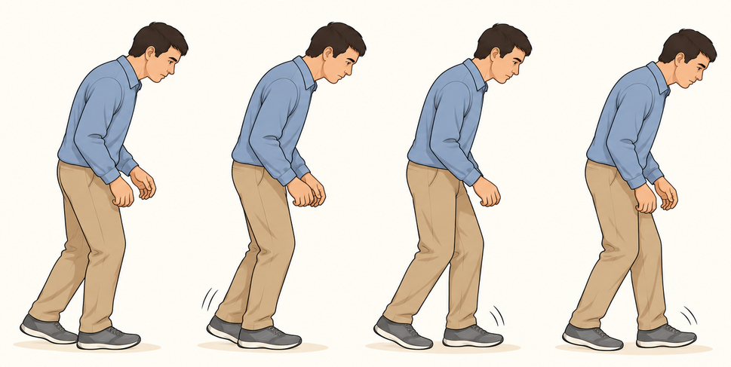
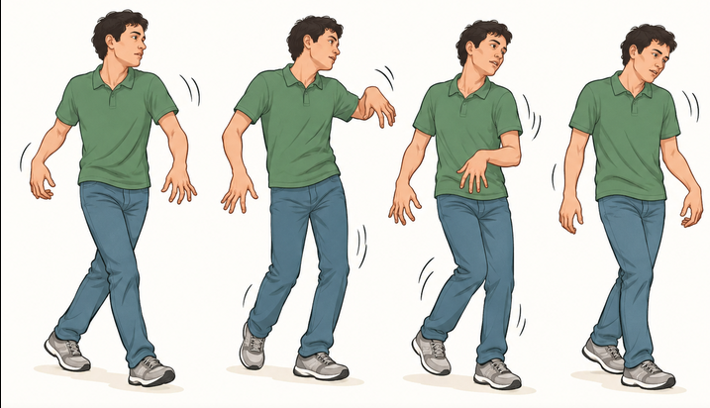
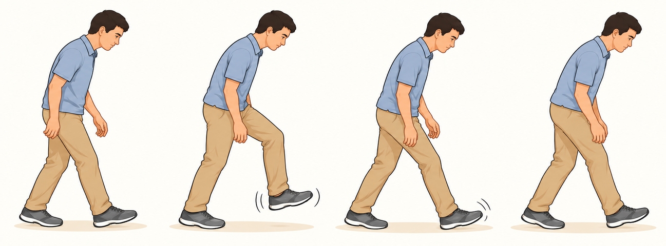
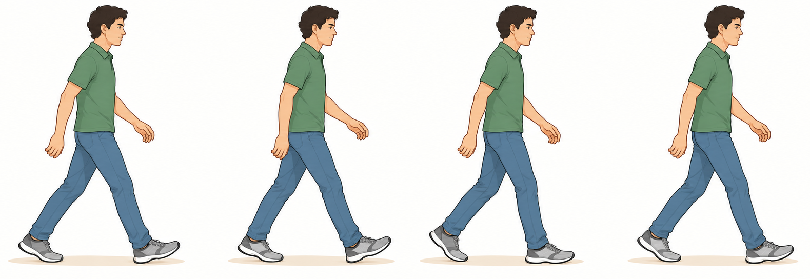
Parkinson’s Disease (PD)
Huntington’s Disease (HD)
Amyotrophic Lateral Sclerosis (ALS)
Healthy Controls
Notes:
Our project considers three neurological diseases and a healthy control group.
Parkinson’s disease mainly affects movement control and can cause short, shuffling steps.
Huntington’s disease affects movement and coordination, which can result in irregular walking patterns.
ALS damages motor neurons and causes muscle weakness, which can affect foot movement and walking stability.
The healthy control group provides a reference for comparing normal and abnormal gait patterns.
By learning these differences, the model attempts to classify walking data into the four categories.

Slide 5
DATASET
Source: PhysioNet — Gait in Neurodegenerative Disease Database
Archive affiliation: Harvard–MIT Division of Health Sciences and Technology
Dataset Overview
  Total subjects: 64
  Healthy Controls: 16
  Parkinson’s Disease: 15
  Huntington’s Disease: 20
  ALS: 13
Preprocessing — Turnaround Pause Removal
  Patients walked back and forth along a 77-metre corridor.
  Turning at each end caused pauses of approximately 3–4 seconds.
  The code filters out these pauses to prevent them from distorting gait measurements.
Data Collection
Sensors: Force-sensitive resistors inside both shoes
Raw signals: Left-foot and right-foot force-related measurements
Sampling frequency: 300 Hz
Recording duration: Approximately 5 minutes per subject
Raw samples: Approximately 90,000 per channel per 5-minute recording
Data Used in Our Model
File format: .ts files
Measurements: Stride, swing, stance and double-support intervals
Approach: Feature extraction and machine-learning classification into four categories

Slide 6
UNDERSTANDING GAIT MEASUREMENTS
The original foot sensors record force-related signals during walking. These signals are processed to derive gait measurements.
  Stride Interval: Time between successive strides of the same foot.
  Stance Interval: Time when the foot is in contact with the ground.
  Swing Interval: Time when the foot is off the ground.
  Double-Support Interval: Time when both feet are in contact with the ground.
Why are these measurements useful?
  They describe walking rhythm, timing and coordination, helping the machine-learning model identify differences between gait patterns.
Notes:
First, the Stride Interval is the time between successive strides of the same foot.
Second, the Stance Interval is the time during which the foot remains in contact with the ground.
Third, the Swing Interval is the time during which the foot is lifted off the ground and moves forward.
Finally, the Double-Support Interval is the time during which both feet are in contact with the ground.

Slide 7
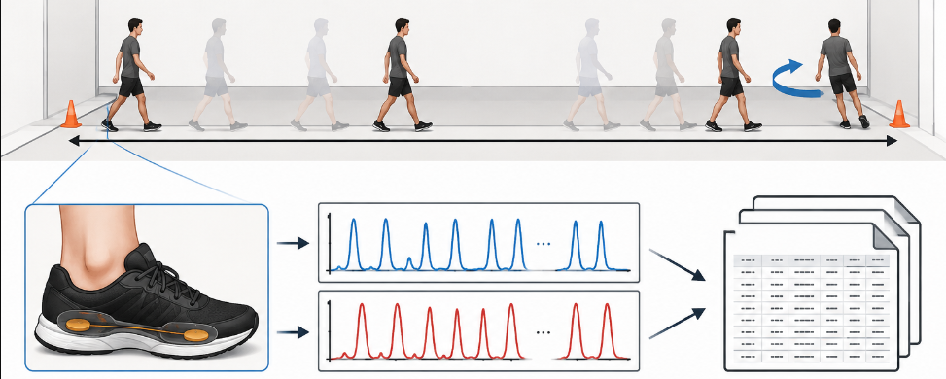

Slide 8
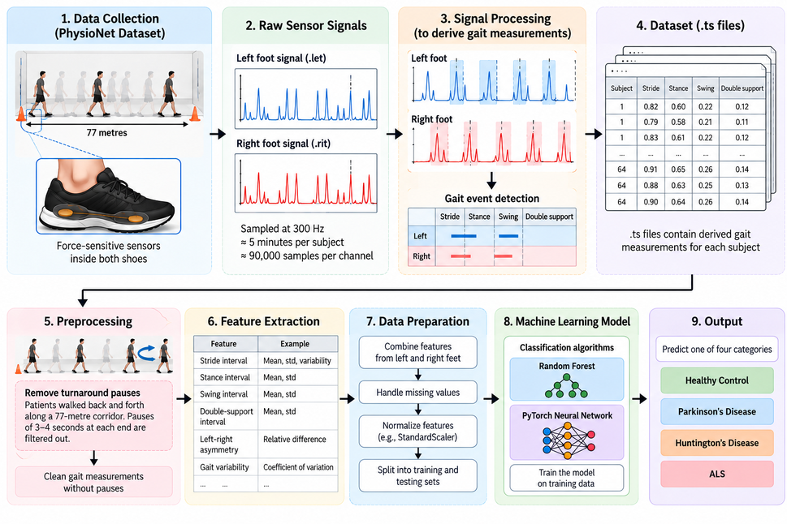
Notes:
Our methodology consists of five stages.
First, in-shoe sensors collect force measurements from both feet.
Second, the continuous signals are divided into overlapping 10-second windows with a 5-second step.
Window duration: 10 seconds
Step between windows: 5 seconds
Overlap: 5 seconds
Sampling frequency: 100 readings per second
Third, features such as stride time, cadence, force measurements and variability are extracted.
Fourth, the machine-learning model analyzes these patterns.
Finally, the system predicts one of four categories: Healthy, PD, HD or ALS.

Slide 9
MACHINE LEARNING MODELS
1. Random Forest
Uses multiple decision trees for classification.
Learns patterns from extracted gait features.
Combines predictions from multiple trees to classify gait categories.
2. PyTorch Neural Network
Learns complex relationships between gait features.
Uses layers of interconnected neurons to identify patterns.
Produces predictions for the four categories: Healthy, PD, HD and ALS.

Slide 10
RESULTS AND PERFORMANCE
Dataset Split
Training: 75%
Testing: 25%
Subject-disjoint split to evaluate performance on unseen subjects
Evaluation Metrics
Accuracy: ~78.44%
Precision: ~78.95%
Recall: ~80.19%
Macro F1-Score: ~79.05%
Key Observation
The model demonstrates promising performance in classifying gait measurements into four categories.
Conclusion
The project uses machine learning to classify gait patterns from clinical gait measurements, with potential to support more accessible gait assessment.

Slide 11
